Slide 1
installing third-party packages, managing environments, and Pandas.
Week 12 | Lecture 1 (12.1)

Slide 2
This Week’s Content
Lecture 12.1
Installing third-party packages, managing environments, and Pandas.
Reading: Chapter 12
Lecture 12.2
More Pandas, NumPy, Matplotlib/Seaborn.
Reading: Chapter 12
Lecture 12.3
Design Problem: Stock Market – Part 1

Slide 3
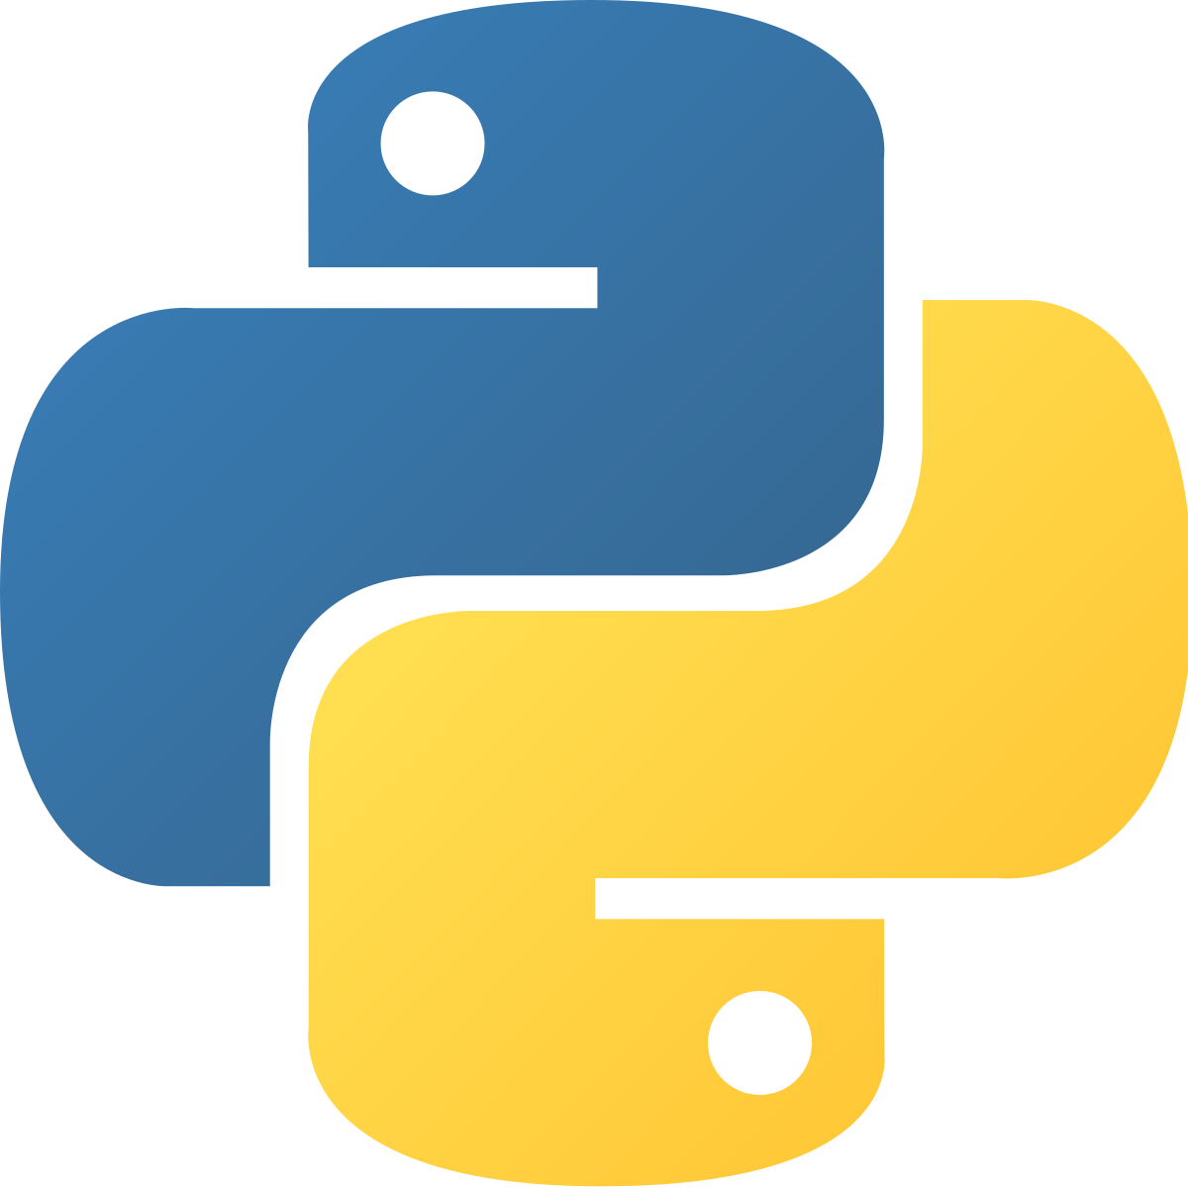
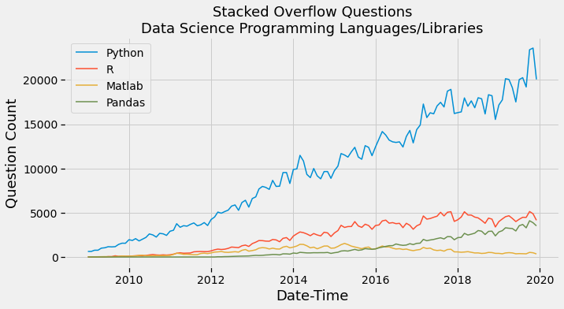
Why Python?
High-level language making it more like a readable, human language than other low-level languages.
Simple and clear syntax.
Large open-source community.
Used by Google, Firefox, Dropbox, Youtube, Instagram, Yelp, NASA, CIA, etc.
The Artificial Intelligence (AI) community overwhelmingly uses Python.

Slide 4
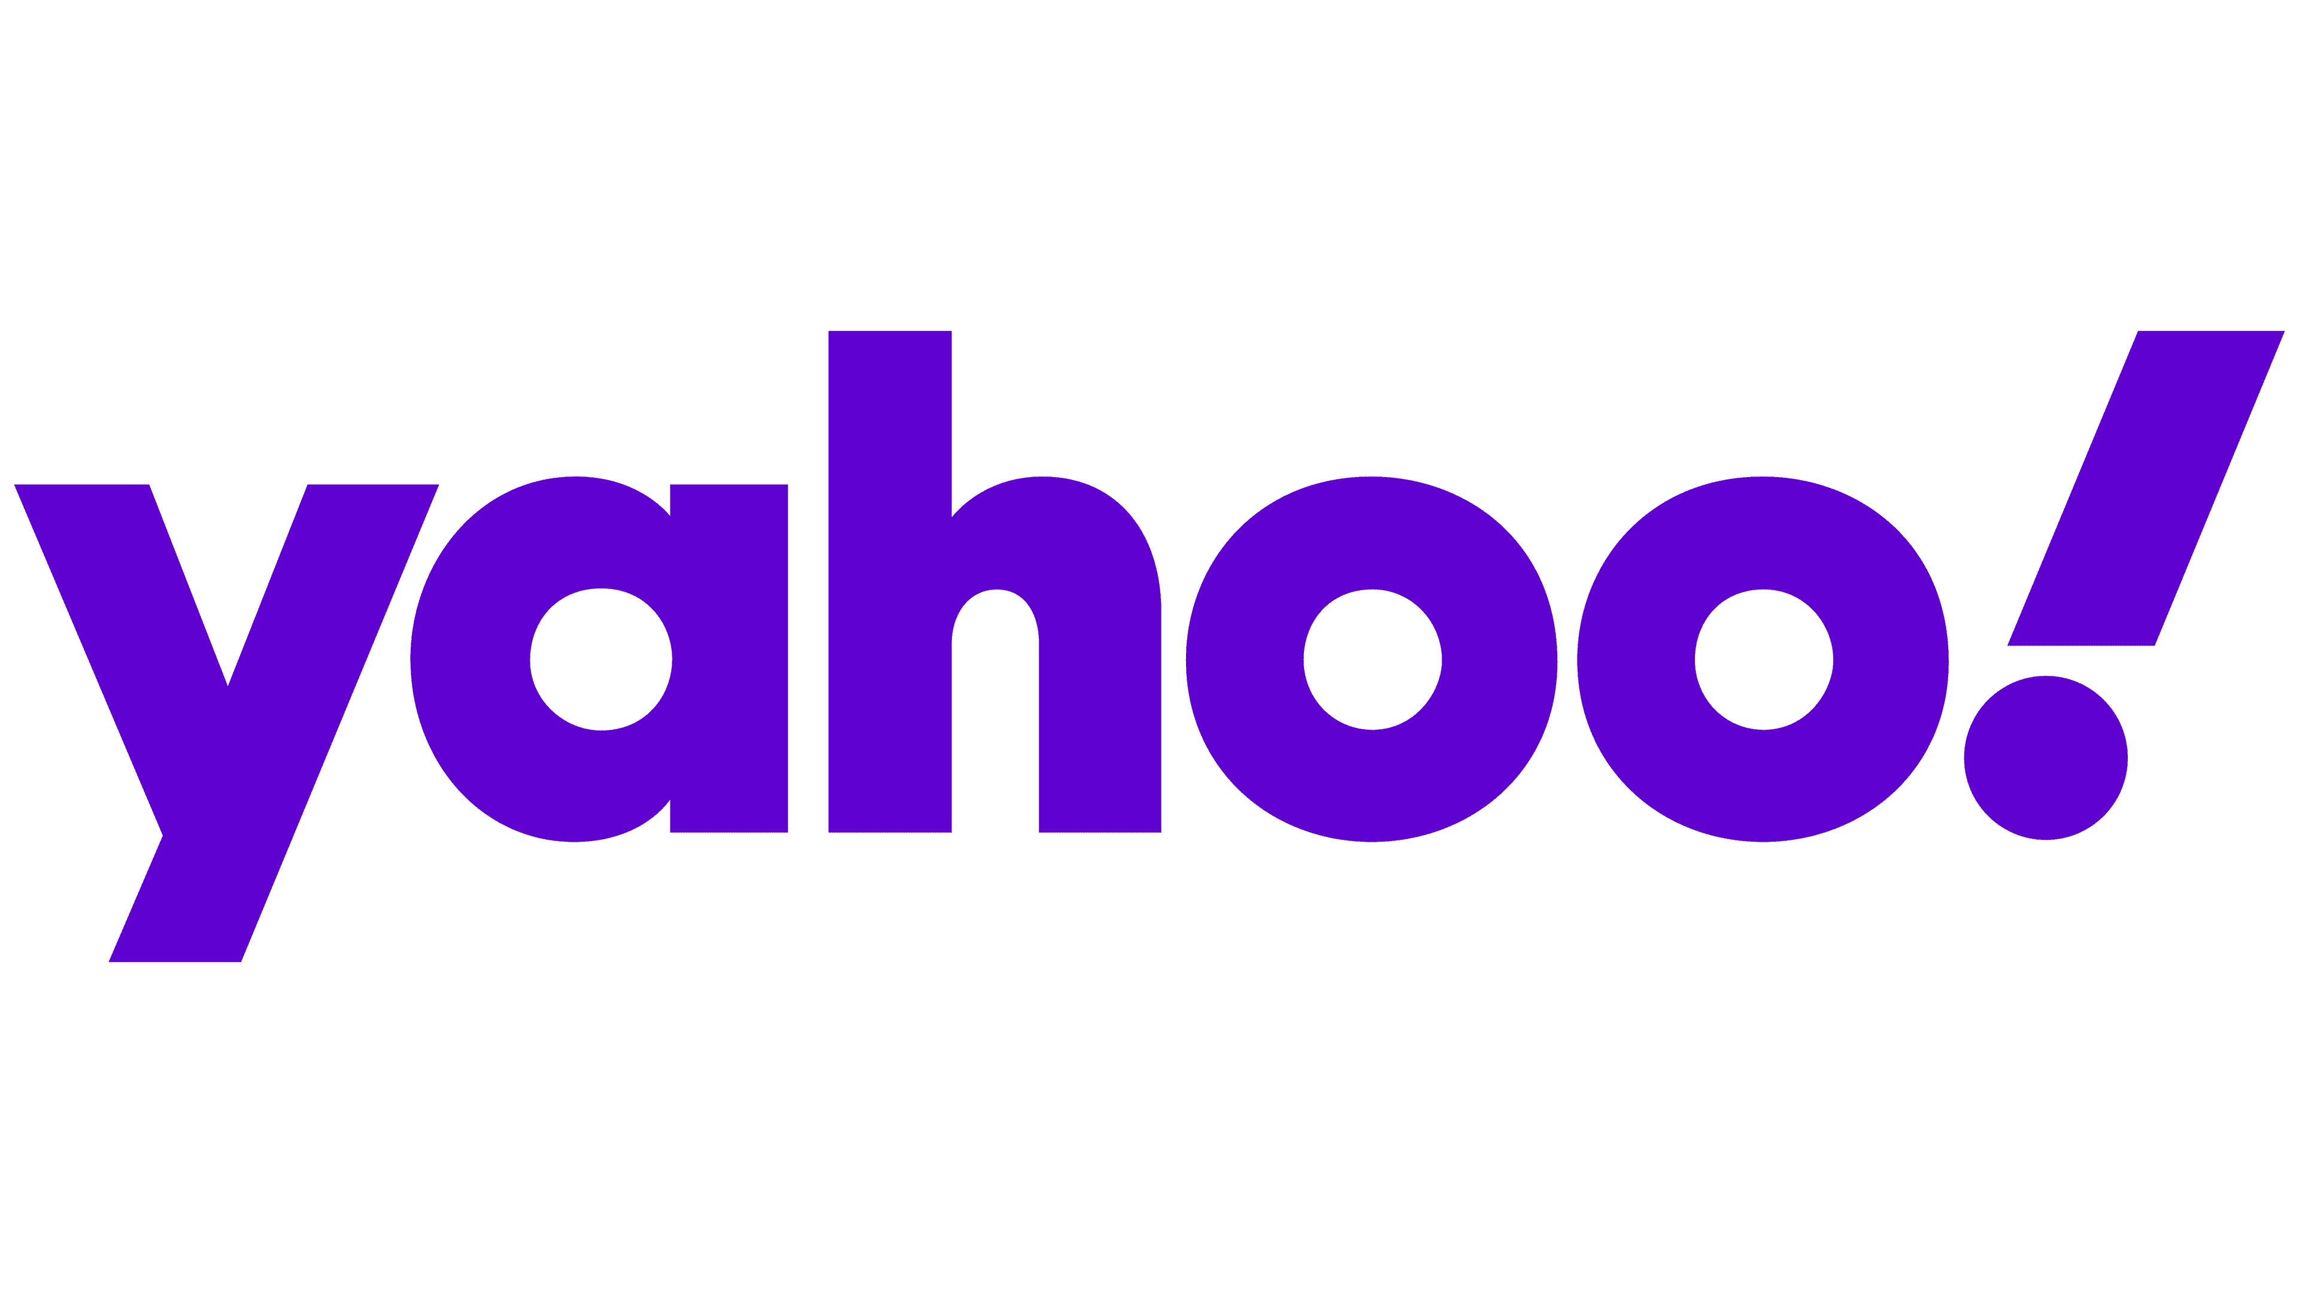




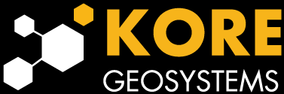
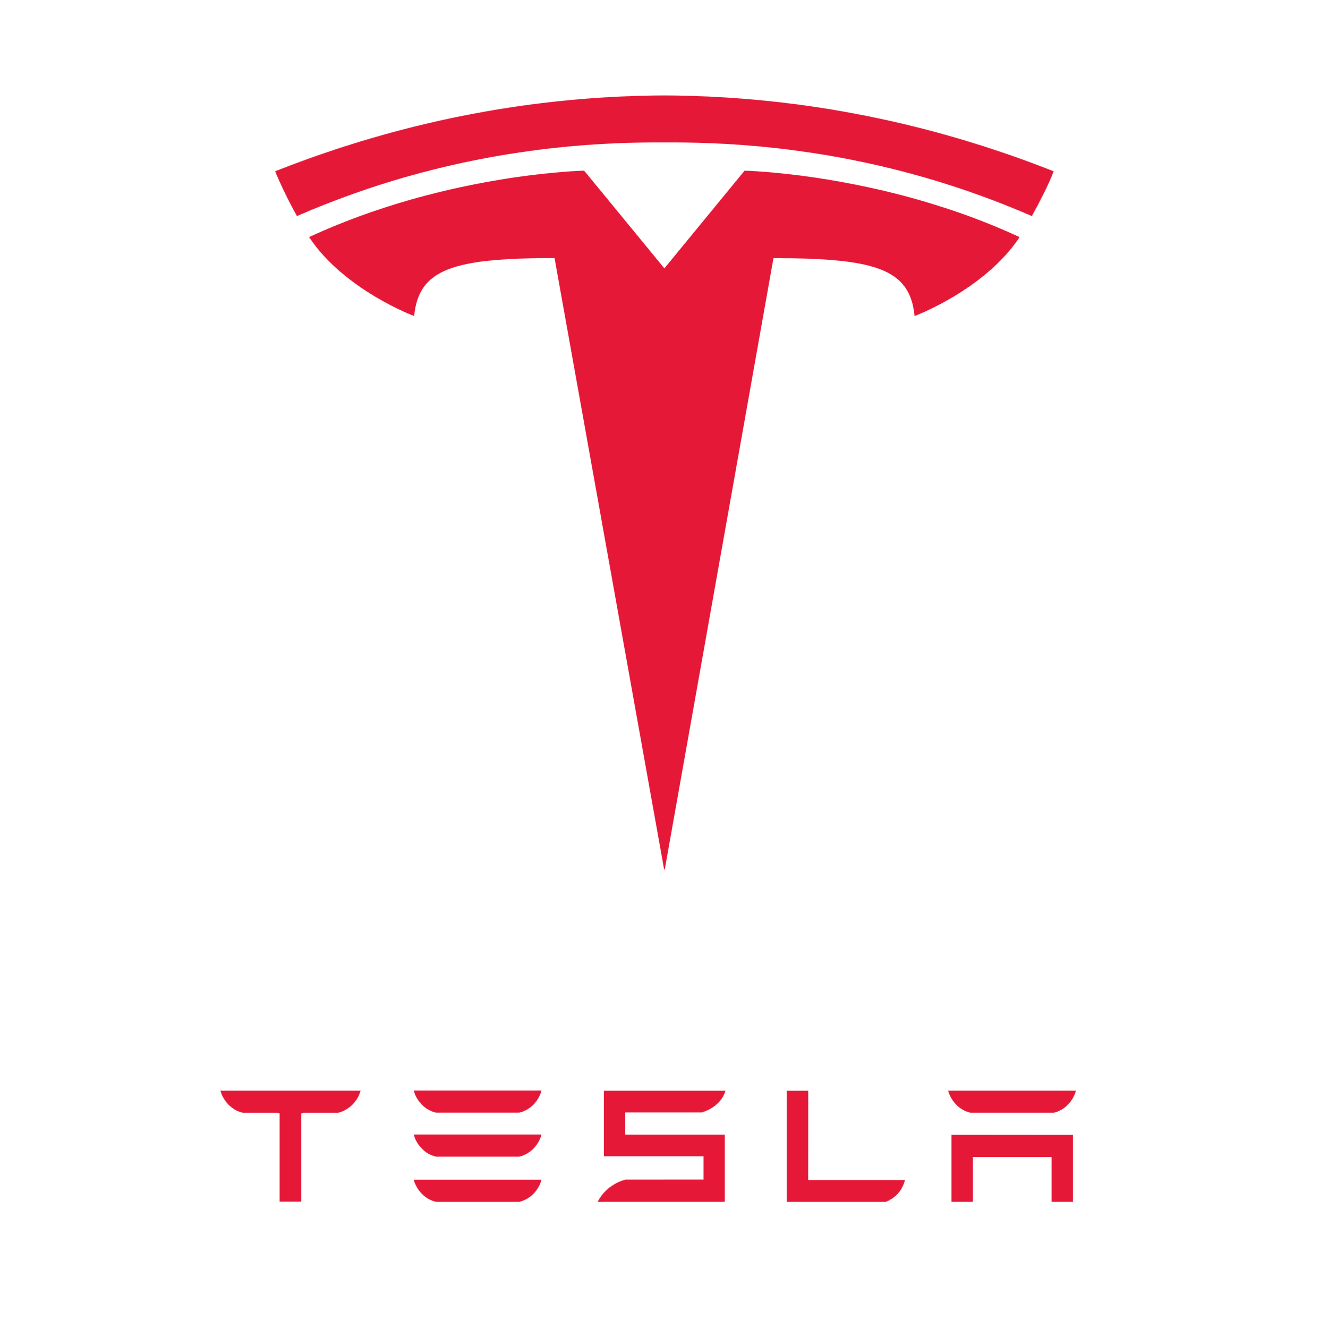


Why Python?
High-level language making it more like a readable, human language than other low-level languages.
Simple and clear syntax.
Large open-source community.
Used by Google, Firefox, Dropbox, Youtube, Instagram, Yelp, NASA, CIA, etc.
The Artificial Intelligence (AI) community overwhelmingly uses Python.

Slide 5
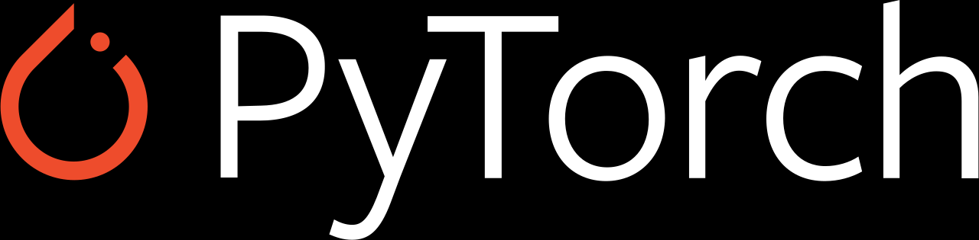

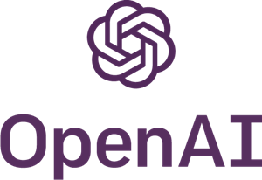

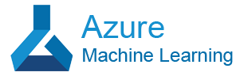
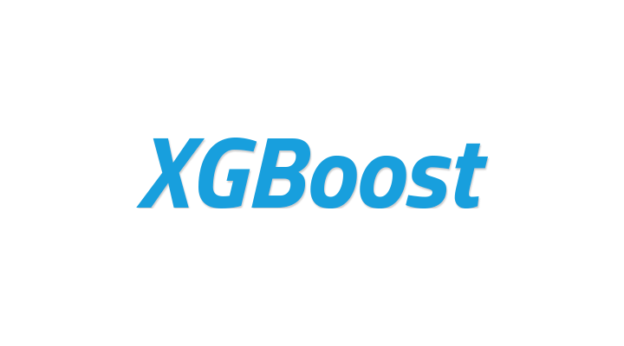
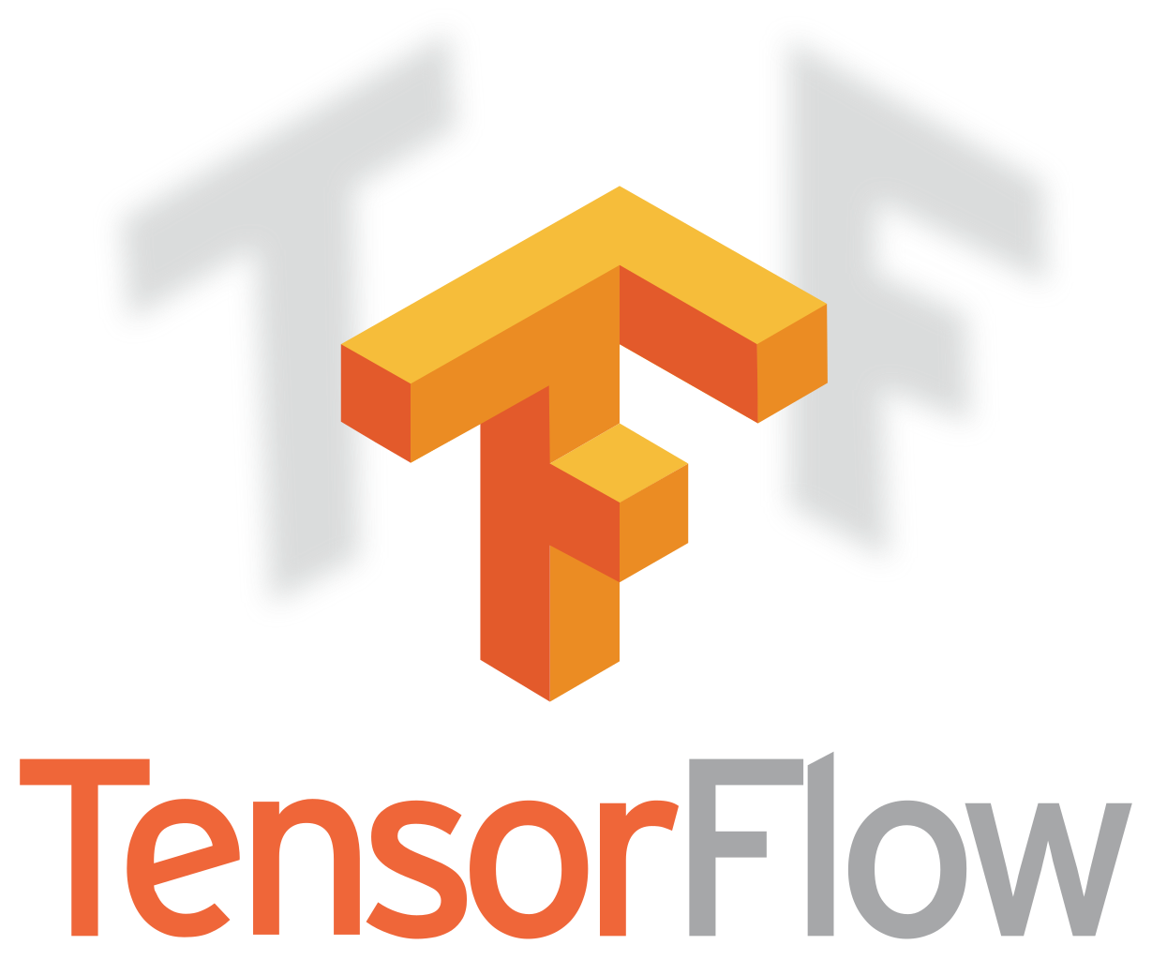


Why Python?
High-level language making it more like a readable, human language than other low-level languages.
Simple and clear syntax.
Large open-source community.
Used by Google, Firefox, Dropbox, Youtube, Instagram, Yelp, NASA, CIA, etc.
The Artificial Intelligence (AI) community overwhelmingly uses Python.

Slide 6
Why Python?
High-level language making it more like a readable, human language than other low-level languages.
Simple and clear syntax.
Large open-source community.
Used by Google, Firefox, Dropbox, Youtube, Instagram, Yelp, NASA, CIA, etc.
The Artificial Intelligence (AI) community overwhelmingly uses Python.

Slide 7
Third-Party Packages.
Up to this point in APS106, we have used libraries that come pre-installed with Python including math, random, turtle, etc.
Now we will introduce you to third-party packages.
These are some common packages/libraries, and we will cover those highlighted in blue.
Package/Library | Common Alias | Description
numpy | np | NumPy includes functions and classes that aid in numerical computation. NumPy is used in many other data science packages.
pandas | pd | pandas provides methods and classes for tabular and time-series data.
sklearn | sk | scikit-learn provides implementations of many machine learning algorithms with a uniform syntax for preprocessing data, specifying models, fitting models with cross-validation, and assessing models.
matplotlib.pyplot | plt | Matplotlib allows the creation of data visualizations in Python. The functions mostly expect NumPy arrays.
seaborn | sns | seaborn also allows the creation of data visualizations but works better with pandas DataFrame objects.
scipy | sp | SciPy provides algorithms and functions for computing problems that arise in science, engineering and statistics.
statsmodels | sm | statsmodels adds functionality to Python to estimate many different kinds of statistical models, make inferences from those models, and explore data.

Slide 8

Anaconda.
PyPi
(Python Package
Index)
NumPy
PyPi and Anaconda are two popular package distribution options.
PyPi has more packages than Anaconda, however, all the most popular scientific, data science, machine learning, AI, etc. packages are on Anaconda.
Anaconda does a better job of managing dependencies.
Anaconda can also manage Python installations and virtual environments, which PyPi cannot, because its just a package index.
Pandas
Matplotlib
Seaborn
Anaconda
(Anaconda Package
Index)
NumPy
Pandas
Seaborn
Matplotlib

Slide 9
Anaconda.
PyPi
(Python Package
Index)
NumPy
Operating System
Python Version
Virtual Environment
Packages
Pandas
Matplotlib
Seaborn
Anaconda
NumPy
Pandas
Seaborn
Matplotlib

Slide 10
Anaconda.
NumPy
Operating System
Python Version
3.10
Virtual Environment
APS106-winter-2024
Packages
numpy-1
pandas-1
seaborn-1
matplotlib-1
Pandas
Matplotlib
Seaborn
NumPy
Pandas
conda install
conda install numpy
conda install pandas
conda install seaborn
conda install matplotlib
Seaborn
Matplotlib

Slide 11
Anaconda.
NumPy
Operating System
pip install
pip install numpy
pip install seaborn
Python Version
3.10
Virtual Environment
APS106-winter-2024
CIV100-winter-2024
Packages
numpy-1
pandas-1
seaborn-1
matplotlib-1
numpy-1
pandas-2
seaborn-2
matplotlib-1
Pandas
Matplotlib
Seaborn
NumPy
Pandas
Seaborn
conda install
conda install pandas
conda install matplotlib
Matplotlib

Slide 12
Anaconda.
NumPy
Operating System
Python Version
3.10
3.11
Virtual Environment
APS106-winter-2024
CIV100-winter-2024
my-cool-website
Packages
numpy-1
pandas-1
seaborn-1
matplotlib-1
numpy-1
pandas-2
seaborn-2
matplotlib-1
pandas-5
seaborn-4
Pandas
Matplotlib
Seaborn
NumPy
Pandas
pip install
pip install pandas
pip install seaborn
Seaborn
Matplotlib

Slide 13
Anaconda.
Operating System
Ideally, you should try to use either pip or conda for installing your packages.
This is not always possible if a package you need is only available on PyPi.
Python Version
3.10
3.11
Virtual Environment
APS106-winter-2024
CIV100-winter-2024
my-cool-website
Packages
numpy-1
pandas-1
seaborn-1
matplotlib-1
numpy-1
pandas-2
seaborn-2
matplotlib-1
pandas-5
seaborn-4

Slide 14
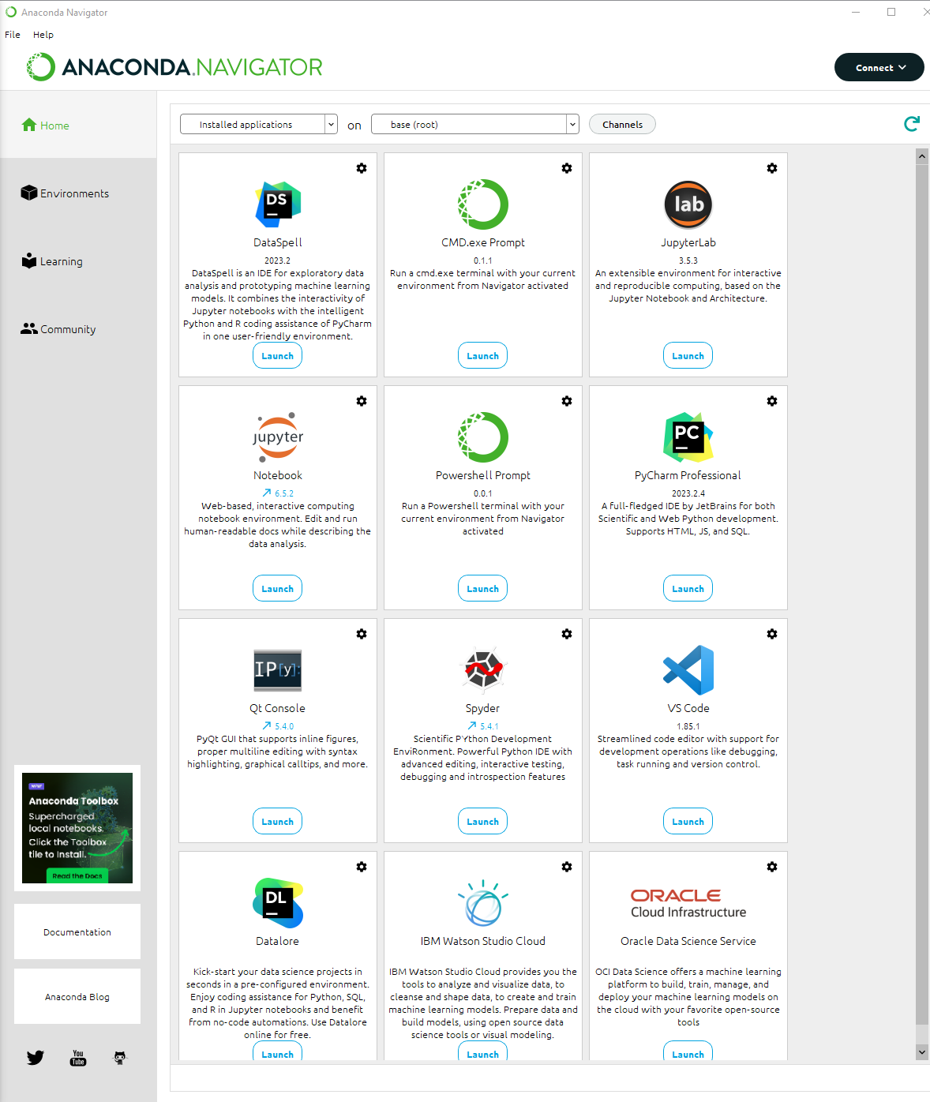
Programming Tools.
Launch and install and update programming tools in Anaconda Navigator.
Integrated Development Environments (IDE).
Notebooks.
Consoles.

Slide 15
Programming Tools.
You and install and update programming tools in Anaconda Navigator.
Integrated Development Environments (IDE).
Notebooks.
Consoles.

Slide 16
Programming Tools.
You and install and update programming tools in Anaconda Navigator.
Integrated Development Environments (IDE).
Notebooks.
Consoles.

Slide 17
Programming Tools.
You and install and update programming tools in Anaconda Navigator.
Integrated Development Environments (IDE).
Notebooks.
Consoles.

Slide 18
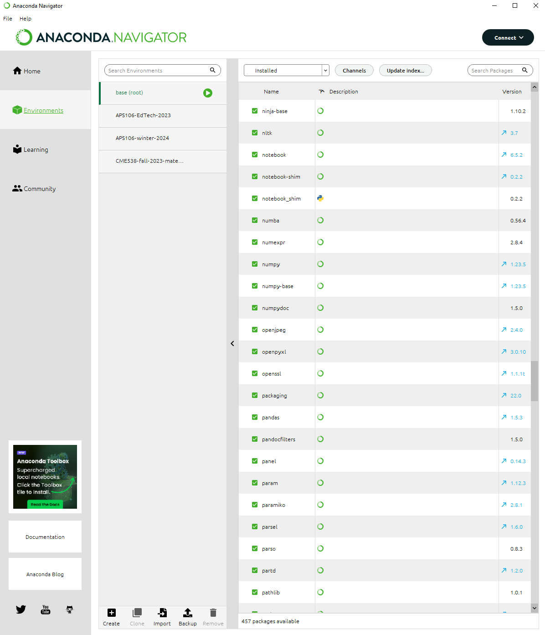
Environments.
These are environments.

Slide 19
Environments.
This environment (base) comes pre-installed with Anaconda and has all the most popular scientific packages installed.

Slide 20
Environments.
These are environments I created.
To create an environment, you can press this button.

Slide 21
Packages.
These are all the packages installed in the (base) environment.

Slide 22
Packages.
This package was install the PyPi package index.
This package was install the Anaconda package index.
I can see the version of this package here.

Slide 23
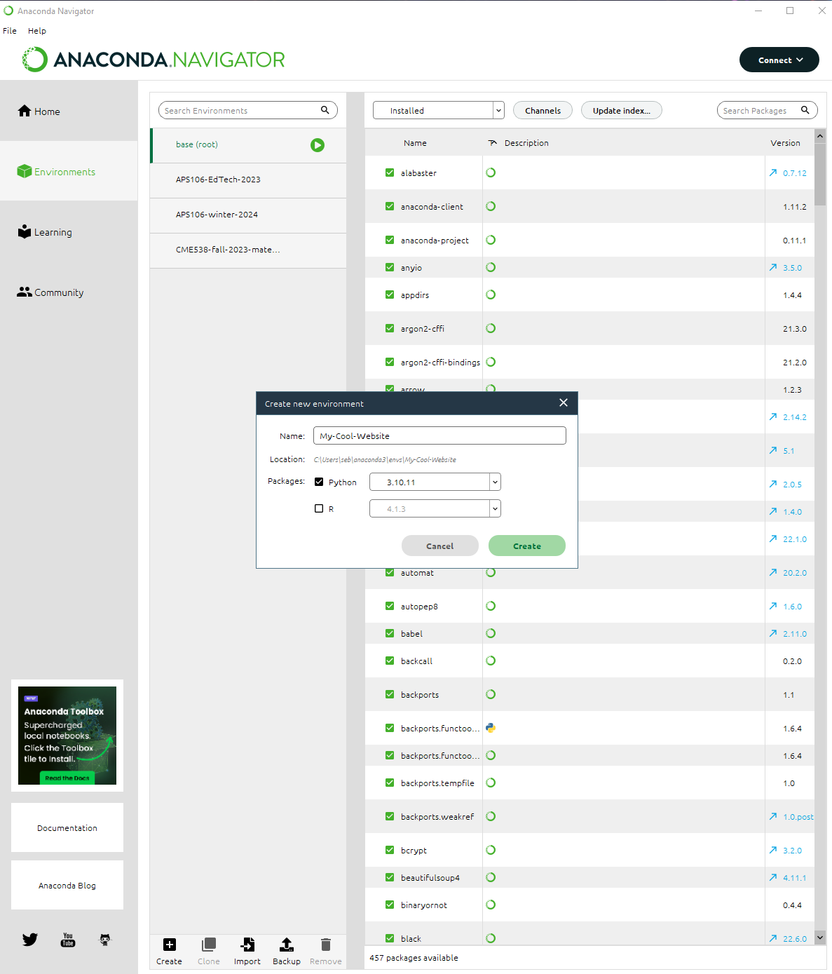
Create An Environment.
Let’s crate a new environment for our new cool website project.
By creating an environment for this project, it will guarantee that our code always works and that our collaborators can always reproduce the environment.
Let’s choose to use Python version 3.10 for this environment.
Choose a name for your environment so it can be easily identified.

Slide 24
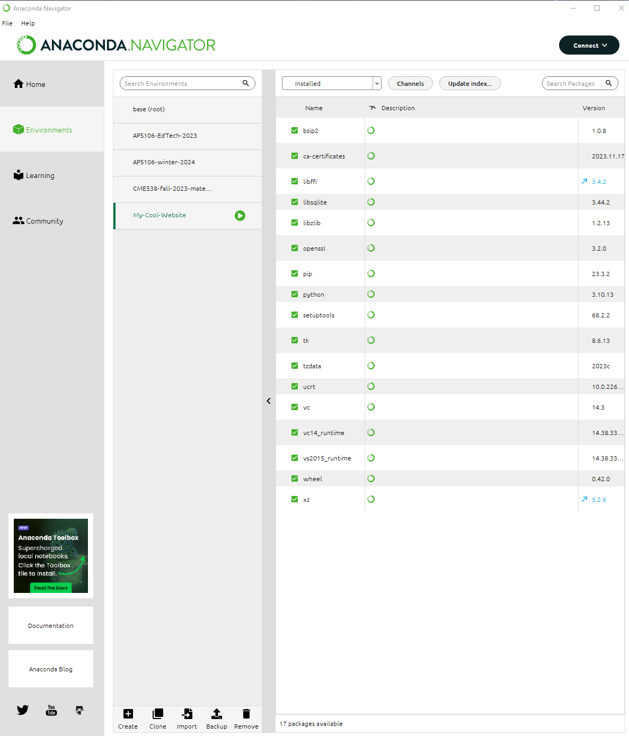
Packages.
When you create a new environment, it is mostly empty except for a few default packages.
For example, you can see the pip package is installed, which allows us to us pip install to install other 3rd party packages.
We can also see that Python version 3.10 is installed.

Slide 25

Packages.

Slide 26
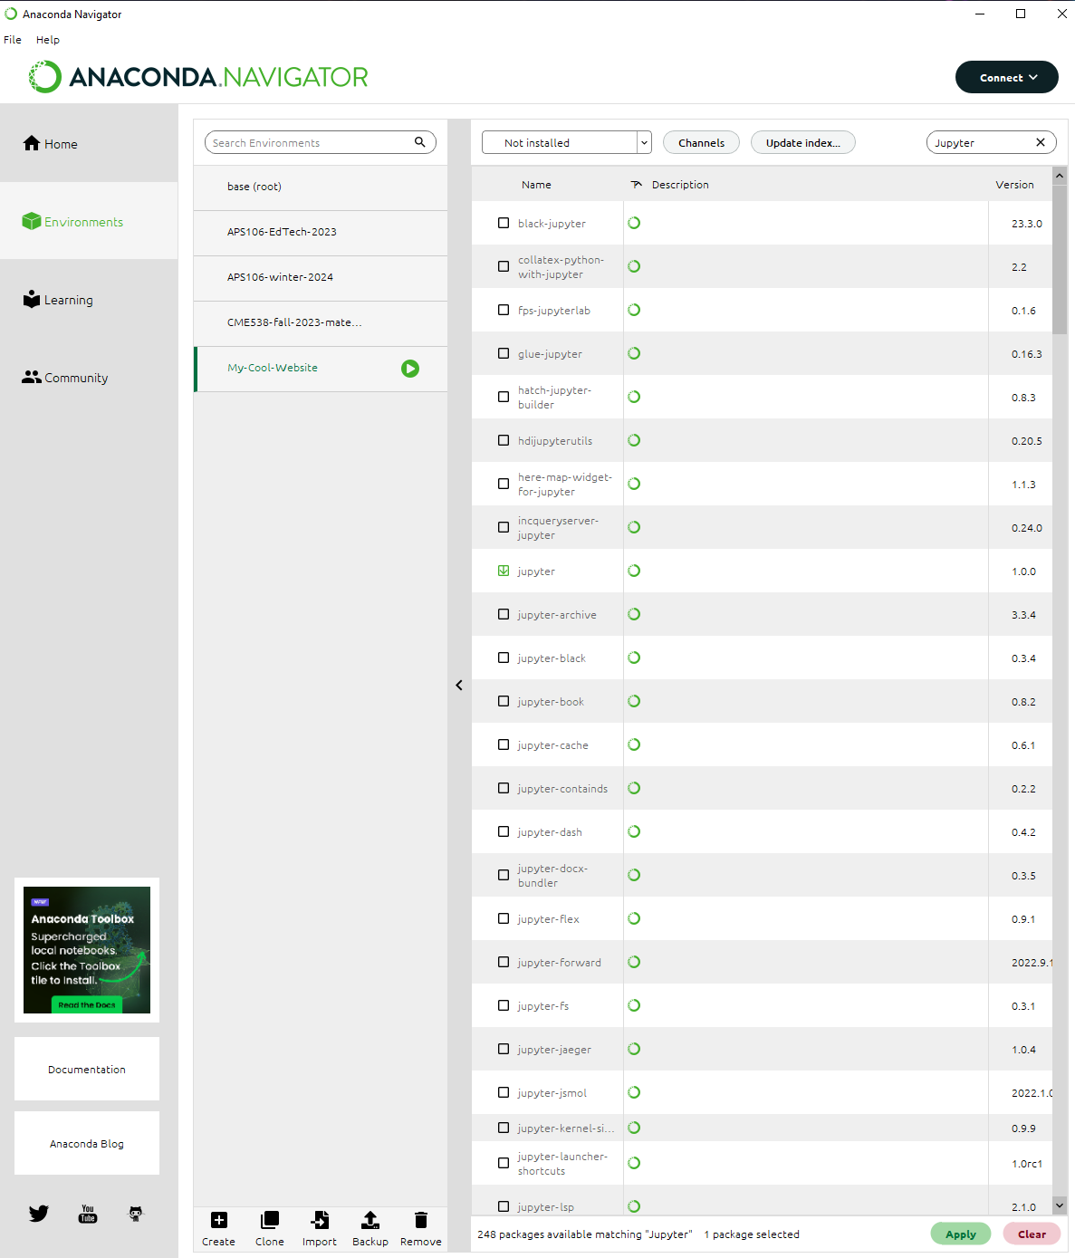
Packages.

Slide 27
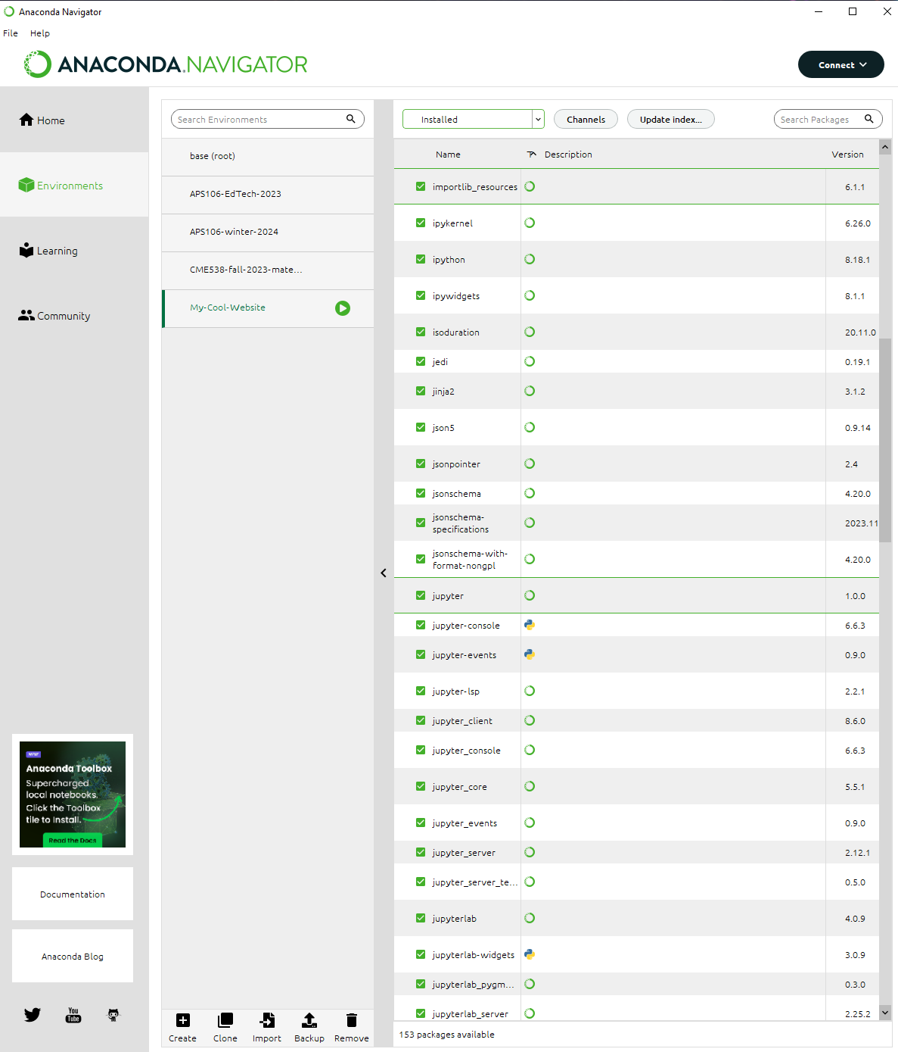
Packages.

Slide 28
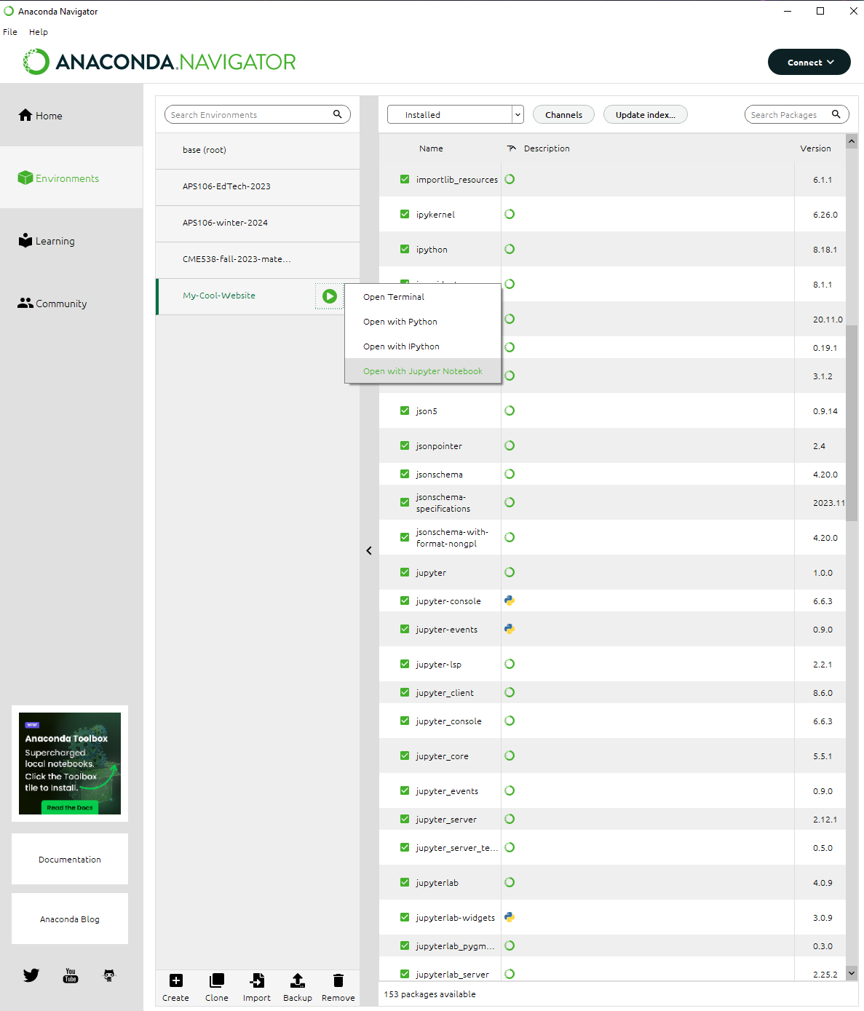
Packages.

Slide 29
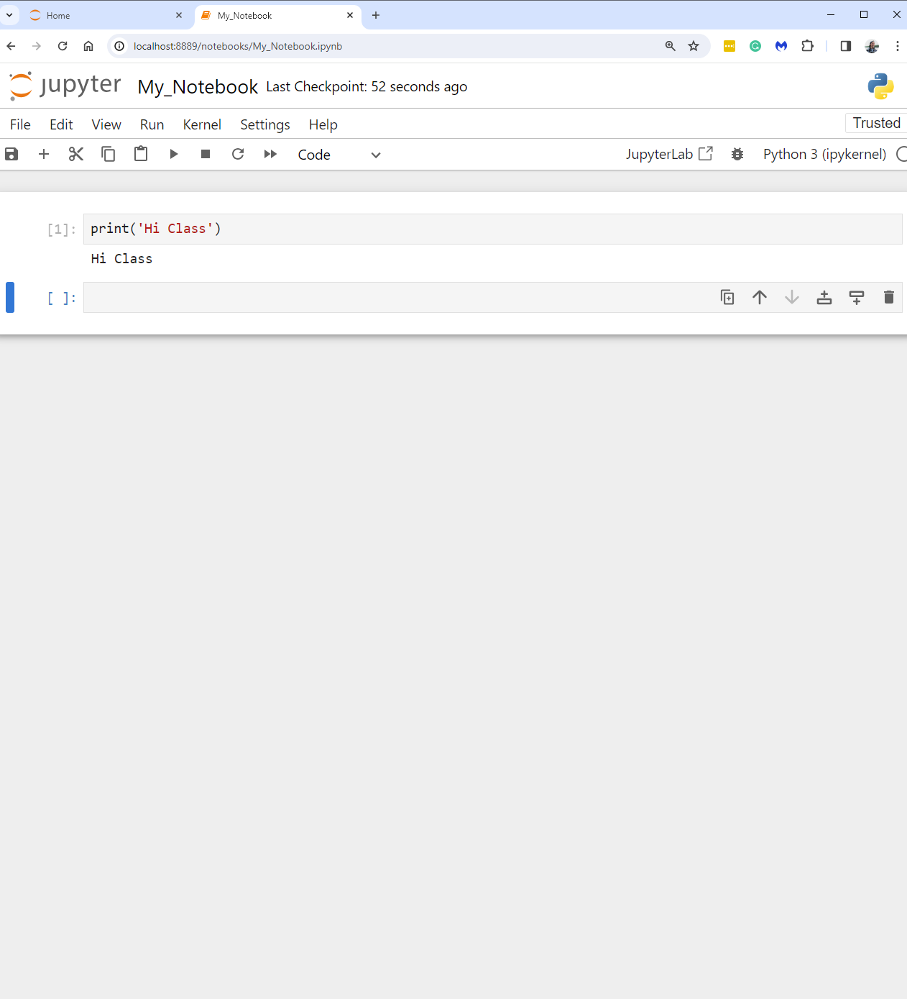
Packages.

Slide 30
installing third-party packages, managing environments, and Pandas.
Week 12 | Lecture 1 (12.1)

